Slide 1
Session 2

Slide 2
Creating and Running Programs
Writing and Editing Programs –Text Editor
Compiling Program -Preprocessor
-Translator
Linking Programs
Executing Programs

Slide 3
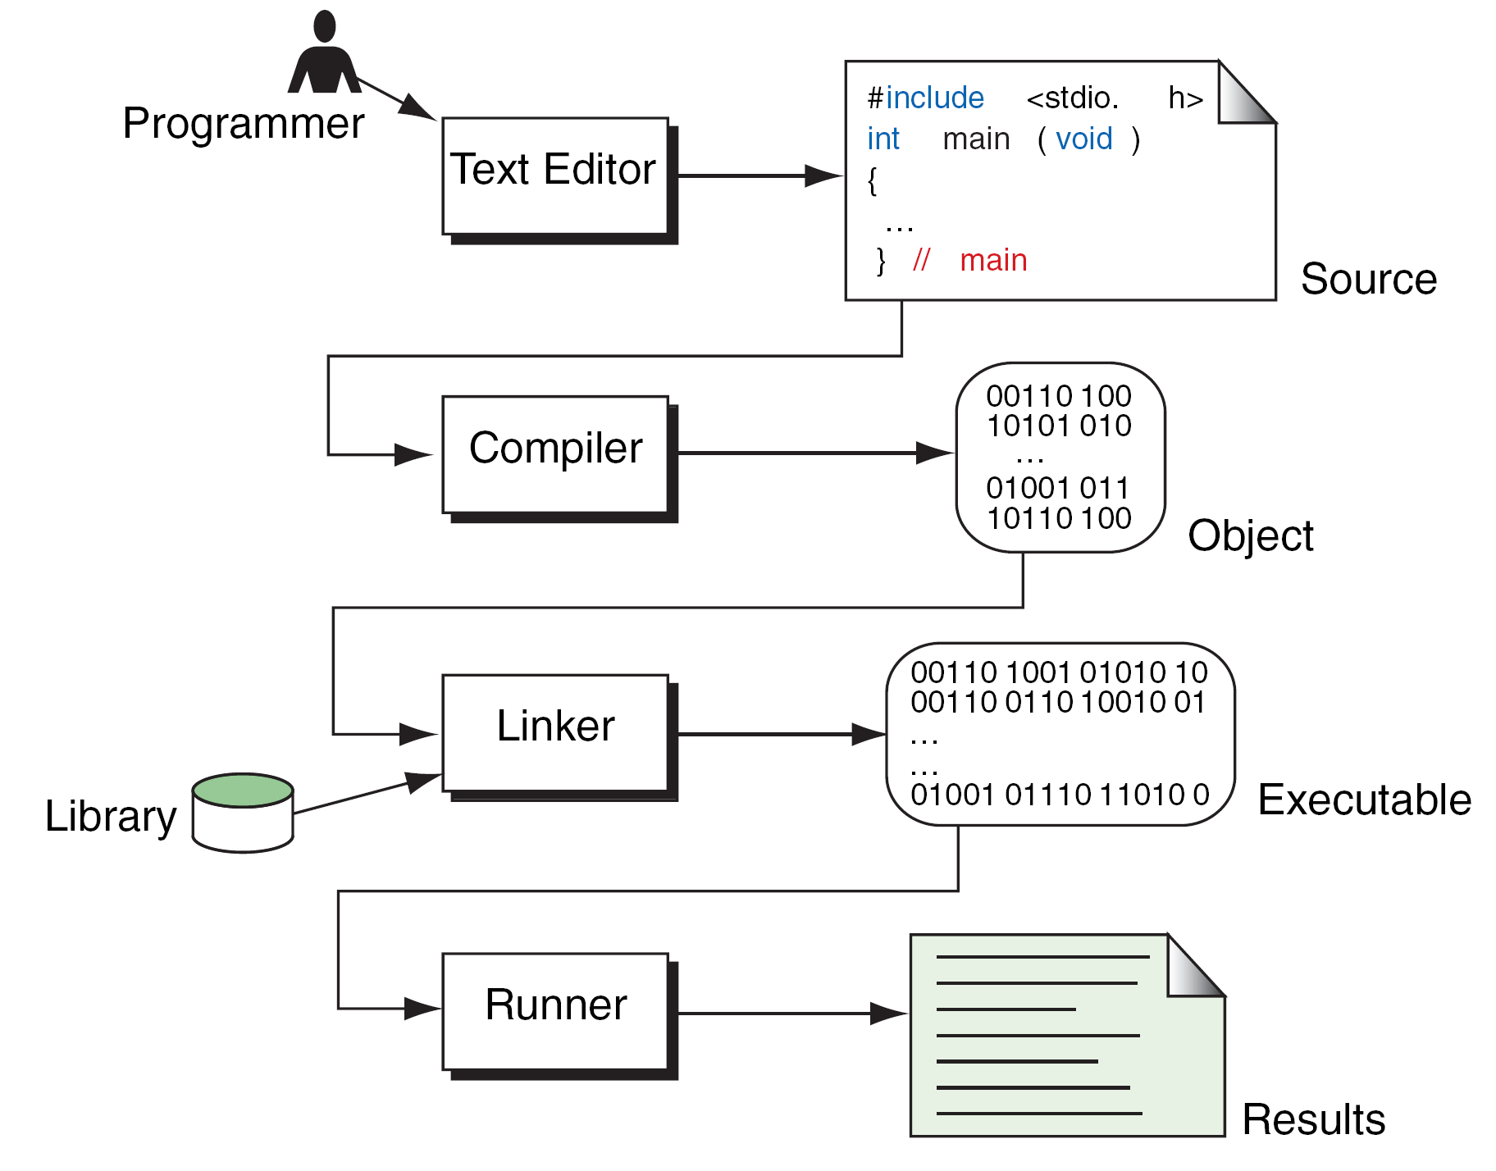
Building a C Program

Slide 4
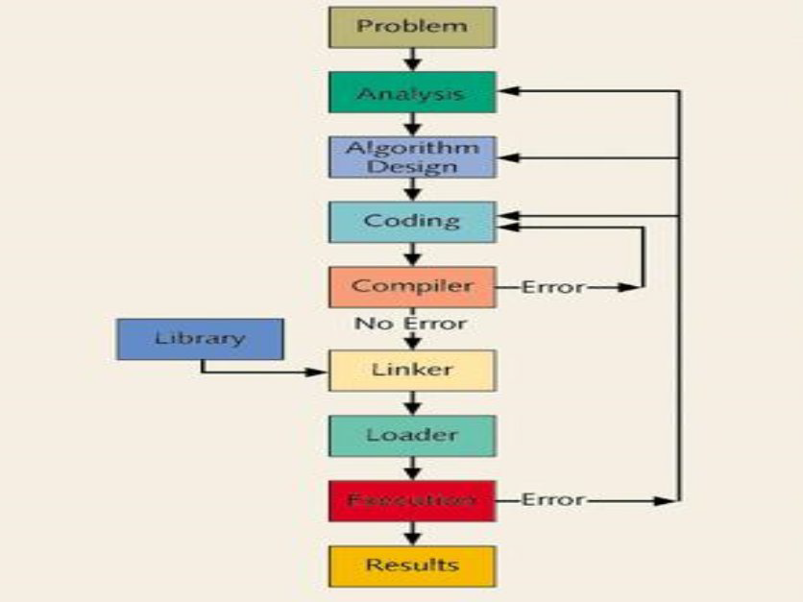

Slide 5
Source code is the program what we write is given to complier
Compiler converts the source code to object code ie machine languague
Object code is linked to linker where library files are loaded and converts in to executable file
Then the compiler runs the program and produces the output.

Slide 6
Program Development
This critical process determines the overall quality and success of our program. If we carefully design each program using good structured development techniques, our programs will be efficient, error-free, and easy to maintain.
System Development Life Cycle
Program Development

Slide 7
1.Understanding the problem
fully understanding the requirements of users
by system analyst & solving problems
2.Develop a solution these tools helps us developing questions
structure charts
pseudo code
Flowcharts

Slide 8
3.Writing the program
top down approach or bottom up
design the algorithm for the program using flowchart or pseudo code
implementation techniques
4. Testing the program
white box testing
Black box testing

Slide 9
Pseudo code
Pseudo code is an artificial and informal language.
One needs to understand the pseudo code properly. Follow the steps. 1)Read the code twice or thrice. 2)Try to understand the input and outcome of the code. 3)Then move to study the code and understand then get the logic. 4)Apply the valid terms of the language into which you want to convert it.

Slide 10
Program: main() { int total; printf("Enter the value of total: "); scanf("%d",&total); if(total>60) { printf("Pass"); } else { printf("Fail"); } getch(); } So,in this way you can convert a pseudo code to a c program ..

Slide 11
ALGORITHMS AND FLOWCHARTS
A typical programming task can be divided into two phases:
Problem solving phase
produce an ordered sequence of steps that describe solution of problem
this sequence of steps is called an algorithm
Implementation phase
implement the program in some programming language

Slide 12
Algorithm
An Algorithm is a finite step-by-step procedure to solve a well-defined computational problem and achieve a required result.
quality of a good algorithm:
Inputs and outputs should be defined precisely.
Each steps in algorithm should be clear and unambiguous.
Algorithm should be most effective among many different ways to solve a problem.
An algorithm shouldn't have computer code. Instead, the algorithm should be written in such a way that, it can be used in similar programming languages.

Slide 13
Example of algorithm
Algorithm/pseudo code to add two numbers
Step 1: Start
Step 2: Read the two numbers in to a,b
Step 3: c=a+b
Step 4: write/print c
Step 5: Stop.

Slide 14
Flowchart
Graphically depicts the logical steps to carry out a task and shows how the steps relate to each other.
Because flowcharts so clearly illustrate the logical flow of programming techniques, they are a valuable tool in the education of programmers

Slide 15
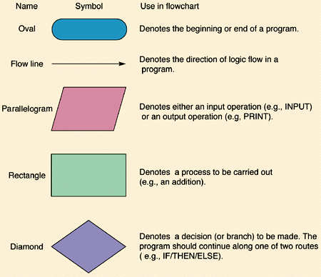

Slide 16
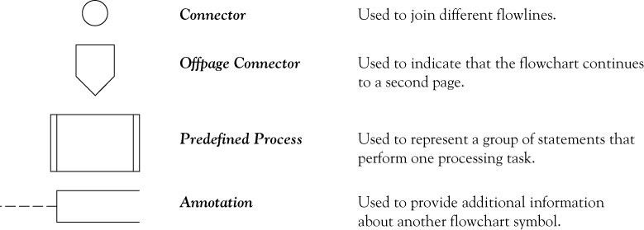

Slide 17
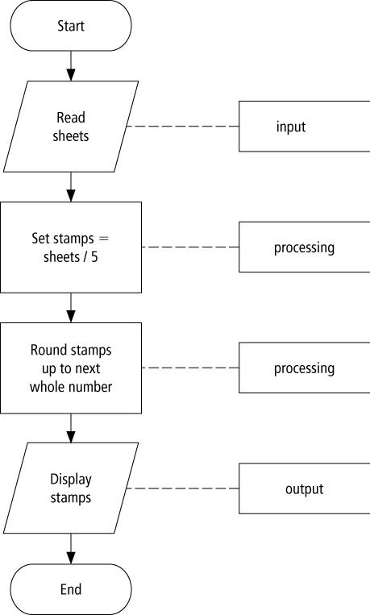

Slide 18
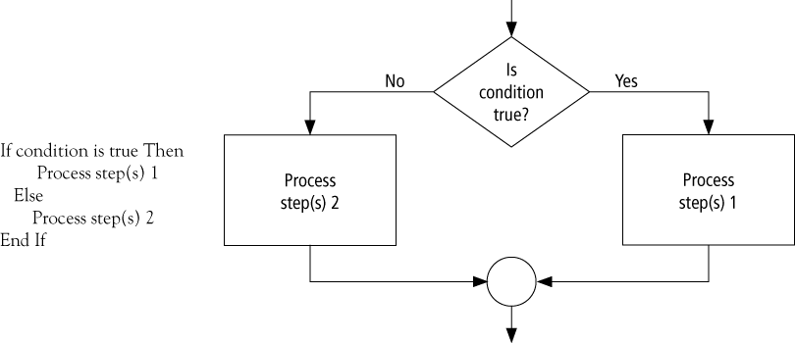
Decision making flowchart

Slide 19
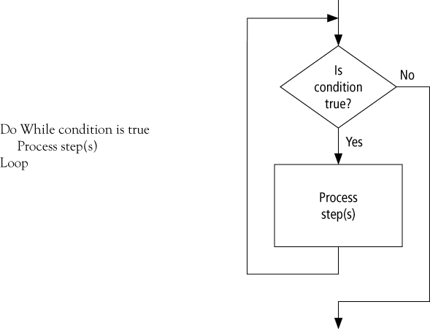
Looping flowchart

Slide 20
Low Level Programming language (machine level)
Assembly Language (psuedo, mnemonic)
High Level Programming Language (English like)
C is middle level language

